Slide 1
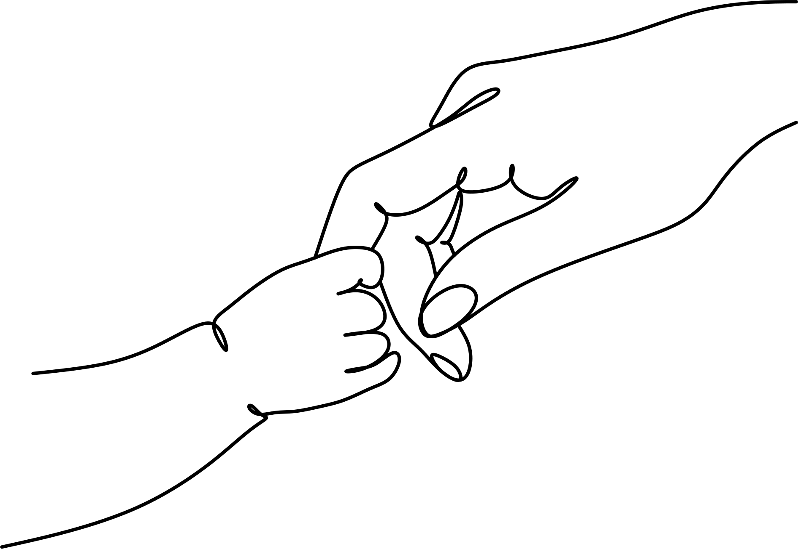
MOTHER'S DAY COUPON
This coupon is good for...
This coupon is good for...
This coupon is good for...
mother's day
EMPTYING THE GARBAGE
mother's day
mother's day
AN UNDISTURBED NAP
mother's day
mother's day
A BACK RUB
mother's day
This coupon is good for...
This coupon is good for...
This coupon is good for...
mother's day
A KISS
mother's day
mother's day
A BIG HUG
mother's day
mother's day
WASHING UP DISHES
mother's day
This coupon is good for...
This coupon is good for...
This coupon is good for...
mother's day
BREAKFAST
ON BED
mother's day
mother's day
ONE HOUR OF HOUSEWORK
mother's day
mother's day
MAKING THE BED WITHOUT BEING ASKED
mother's day
This coupon is good for...
This coupon is good for...
This coupon is good for...
mother's day
ONE EXTRA CHORE
mother's day
mother's day
A MOVIE NIGHT
mother's day
mother's day
AN UNDISTURBED NAP
mother's day
This coupon is good for...
This coupon is good for...
This coupon is good for...
mother's day
COOKING WITH MOM
mother's day
mother's day
ROOM
CLEANUP
mother's day
mother's day
A NICE
WALKING
mother's day
This coupon is good for...
This coupon is good for...
This coupon is good for...
mother's day
PICNIC IN
A PARK
mother's day
mother's day
PICKUP TOYS
mother's day
mother's day
NO COMPLAINTS
mother's day

