Slide 1
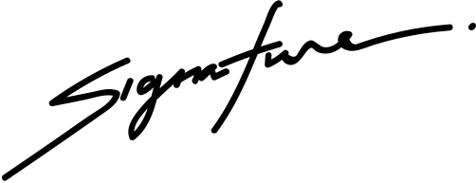
CERTIFICATE OF SCHOLARSHIP
PROUDLY PRESENTED TO
KORINA VILLANUEVA
in honor of your outstanding performance in the ABC Program.
BENJAMIN SHAH
08 AUGUST 2028
School President
Date

