Slide 1
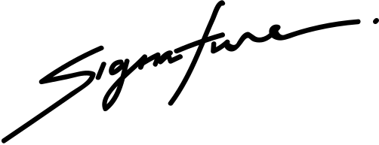
Certificate of
Scholarship
This certifies that
Isabel Mercado
in honor of your outstanding performance
in the ABC Program.
CHRISTINA SHERLY
CLAIRE A. MAURA
Curriculum Dean
School Director

