Slide 1
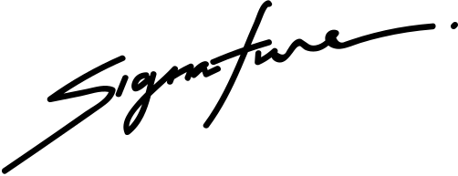
CERTIFICATE OF SCHOLARSHIP
THIS IS TO CERTIFY THAT
Marceline Anderson
in honor of your outstanding performance in the ABC Program.
10 DECEMBER 2029
NOAH SCHUMACHER
Date
The Chariman

