Slide 1
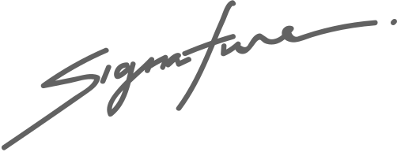
Certificate of Completion
THIS DIPLOMA IS GIVEN TO
STEPHEN HARPER
as having completed all requirements
stipulated by ABC High School.
Richard Sanchez
Margaret Bailey
SCHOOL PRINCIPAL
EDUCATION CHAIRMAN

