Slide 1
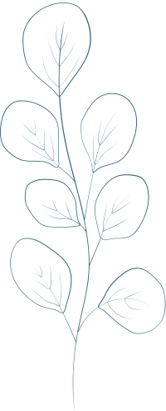
Weekend
To Do List
Name:
Saturday
Sunday

