Slide 1
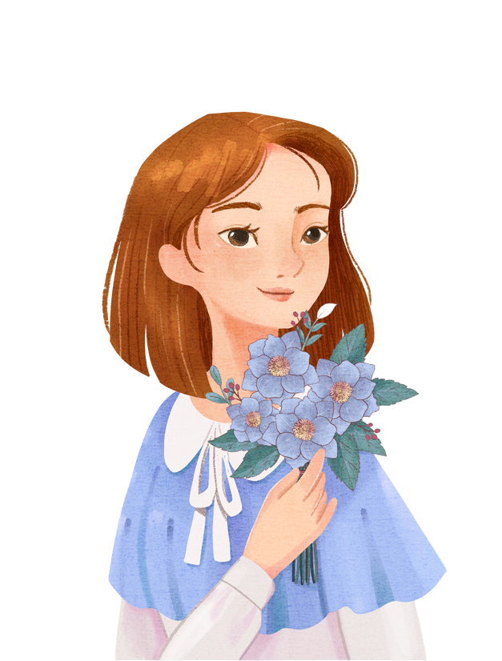
Girly cute checklist
Note

