Slide 1
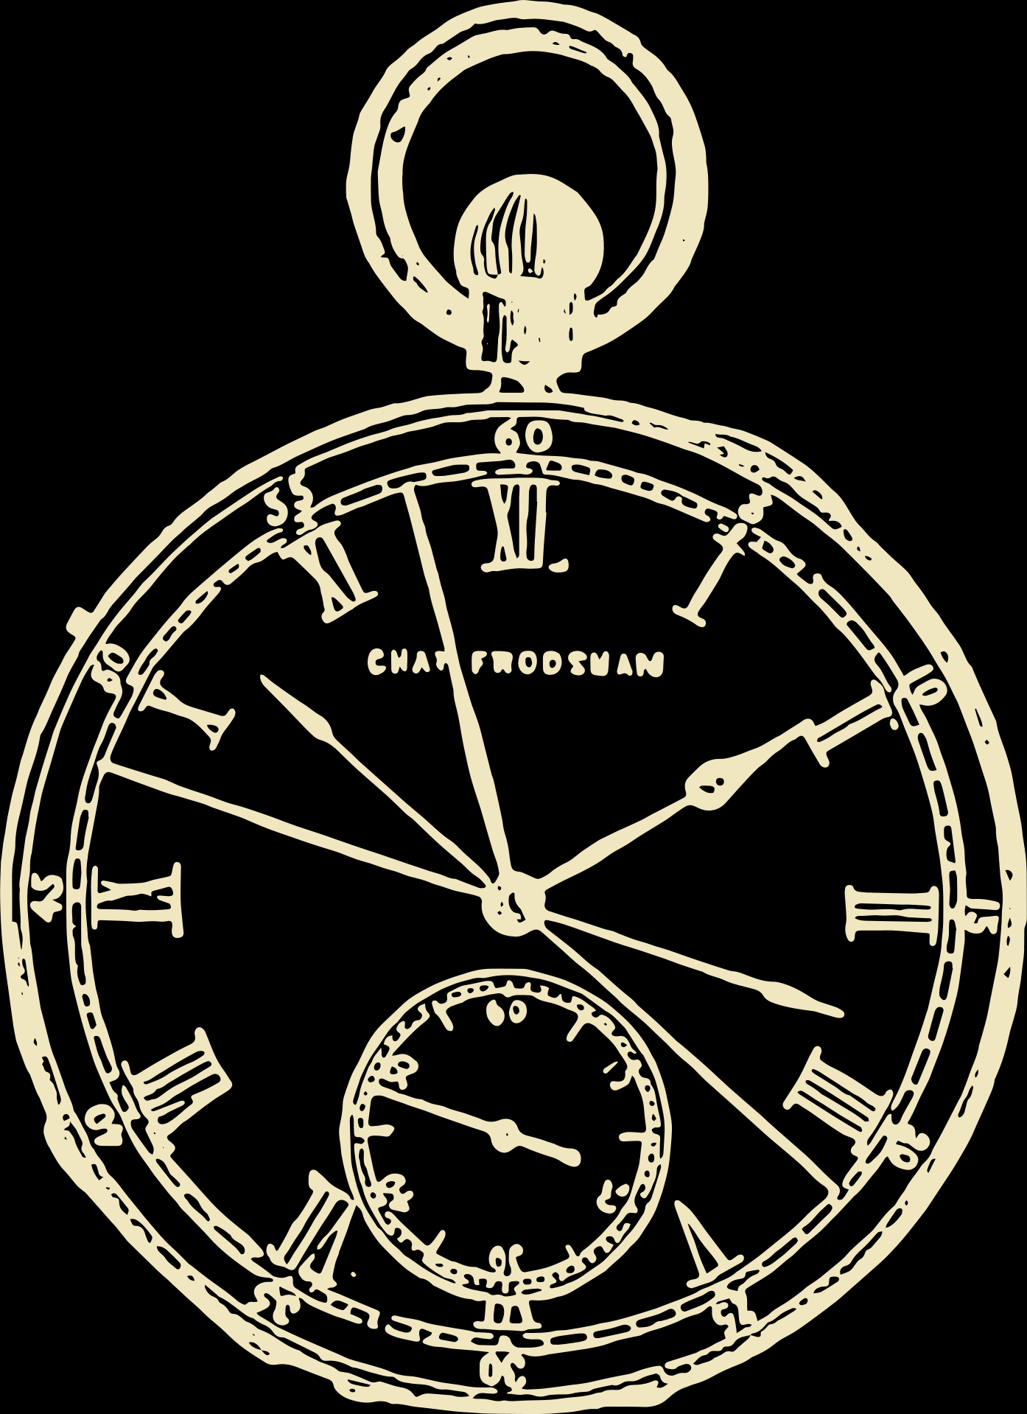
Belle Steele
• SEAT 34 •

