Slide 1
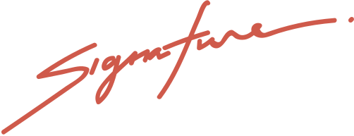
WORLD'S BEST MOM AWARD
This is proudly given to
Sheryl Vandenb
for being the coolest, most loving,
and most caring mom in the entire universe!
ISABEL MERCADO
LEXIE HAYWOOD
Child No.1
Child No.2

