Slide 1
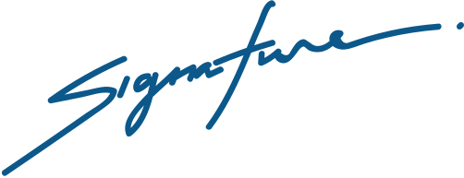
THIS CERTIFICATE IS PROUDLY PRESENTED TO
SAID TURNER
has completed all requirements for the course
of Economic Law course.
CERTIFICATE
OF PARTICIPATION
Olivia Wilson
Taylor Alonso
Director
Headmaster

