Slide 1
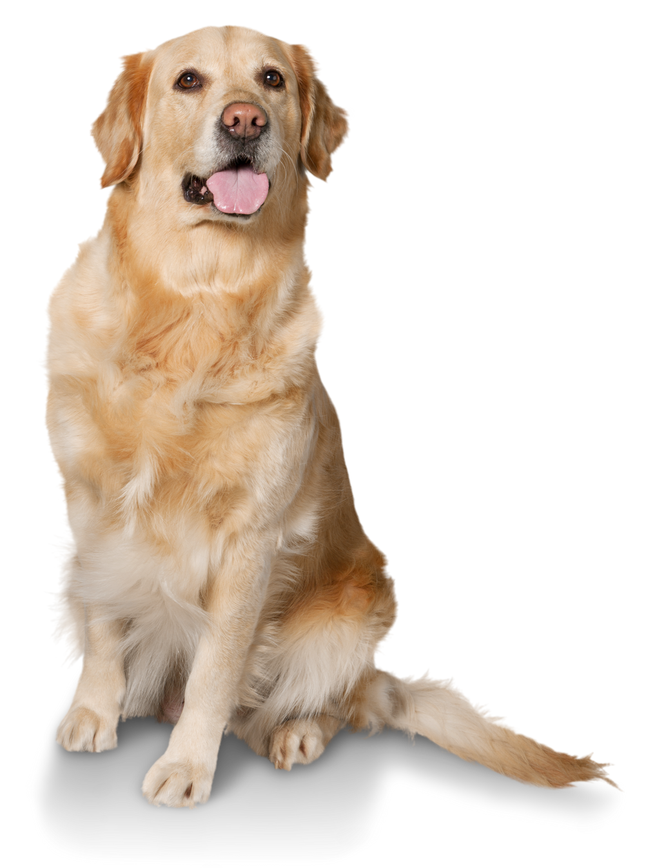
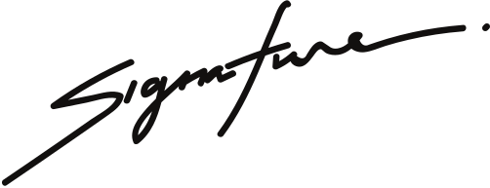
Birth Certificate
This certifies that
DOG NAME
is a male puppy born on August 8th, 2021
to parents, David and Anna.
CHRISTINA SHERLY
Pet shop manager

