Slide 1
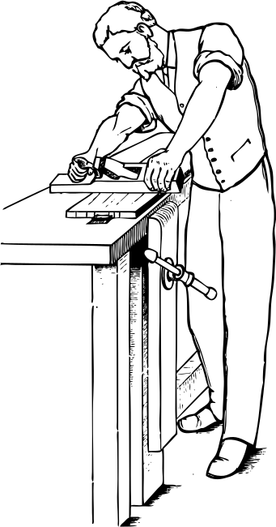
Woodcraft Carpenter
The slogan of the company
Dear Mr. John Doe,
A letterhead refers to the heading at the top of a sheet of letter paper. It usually consists of a name and an address, or a logo. This often appears in letters created by companies and individuals for communicating messages, whether it’s within the team, business partners, or with clients.
Letterheads are important branding tools as well, as they are sent out to a wide audience. They can set the tone for messages while showcasing your company’s expertise and professionalism.
This makes it important for you to create a letterhead that captures your brand’s identity while presenting important details. It helps to create a template that you can use for different occasions, from inter-office memos to customer correspondences.
Yours sincerely,
Eleanor Fitzgerald
(123) 456 7890
hello@reallygreatsite.com
123 Anywhere St., Any City ST 12345

