Slide 1
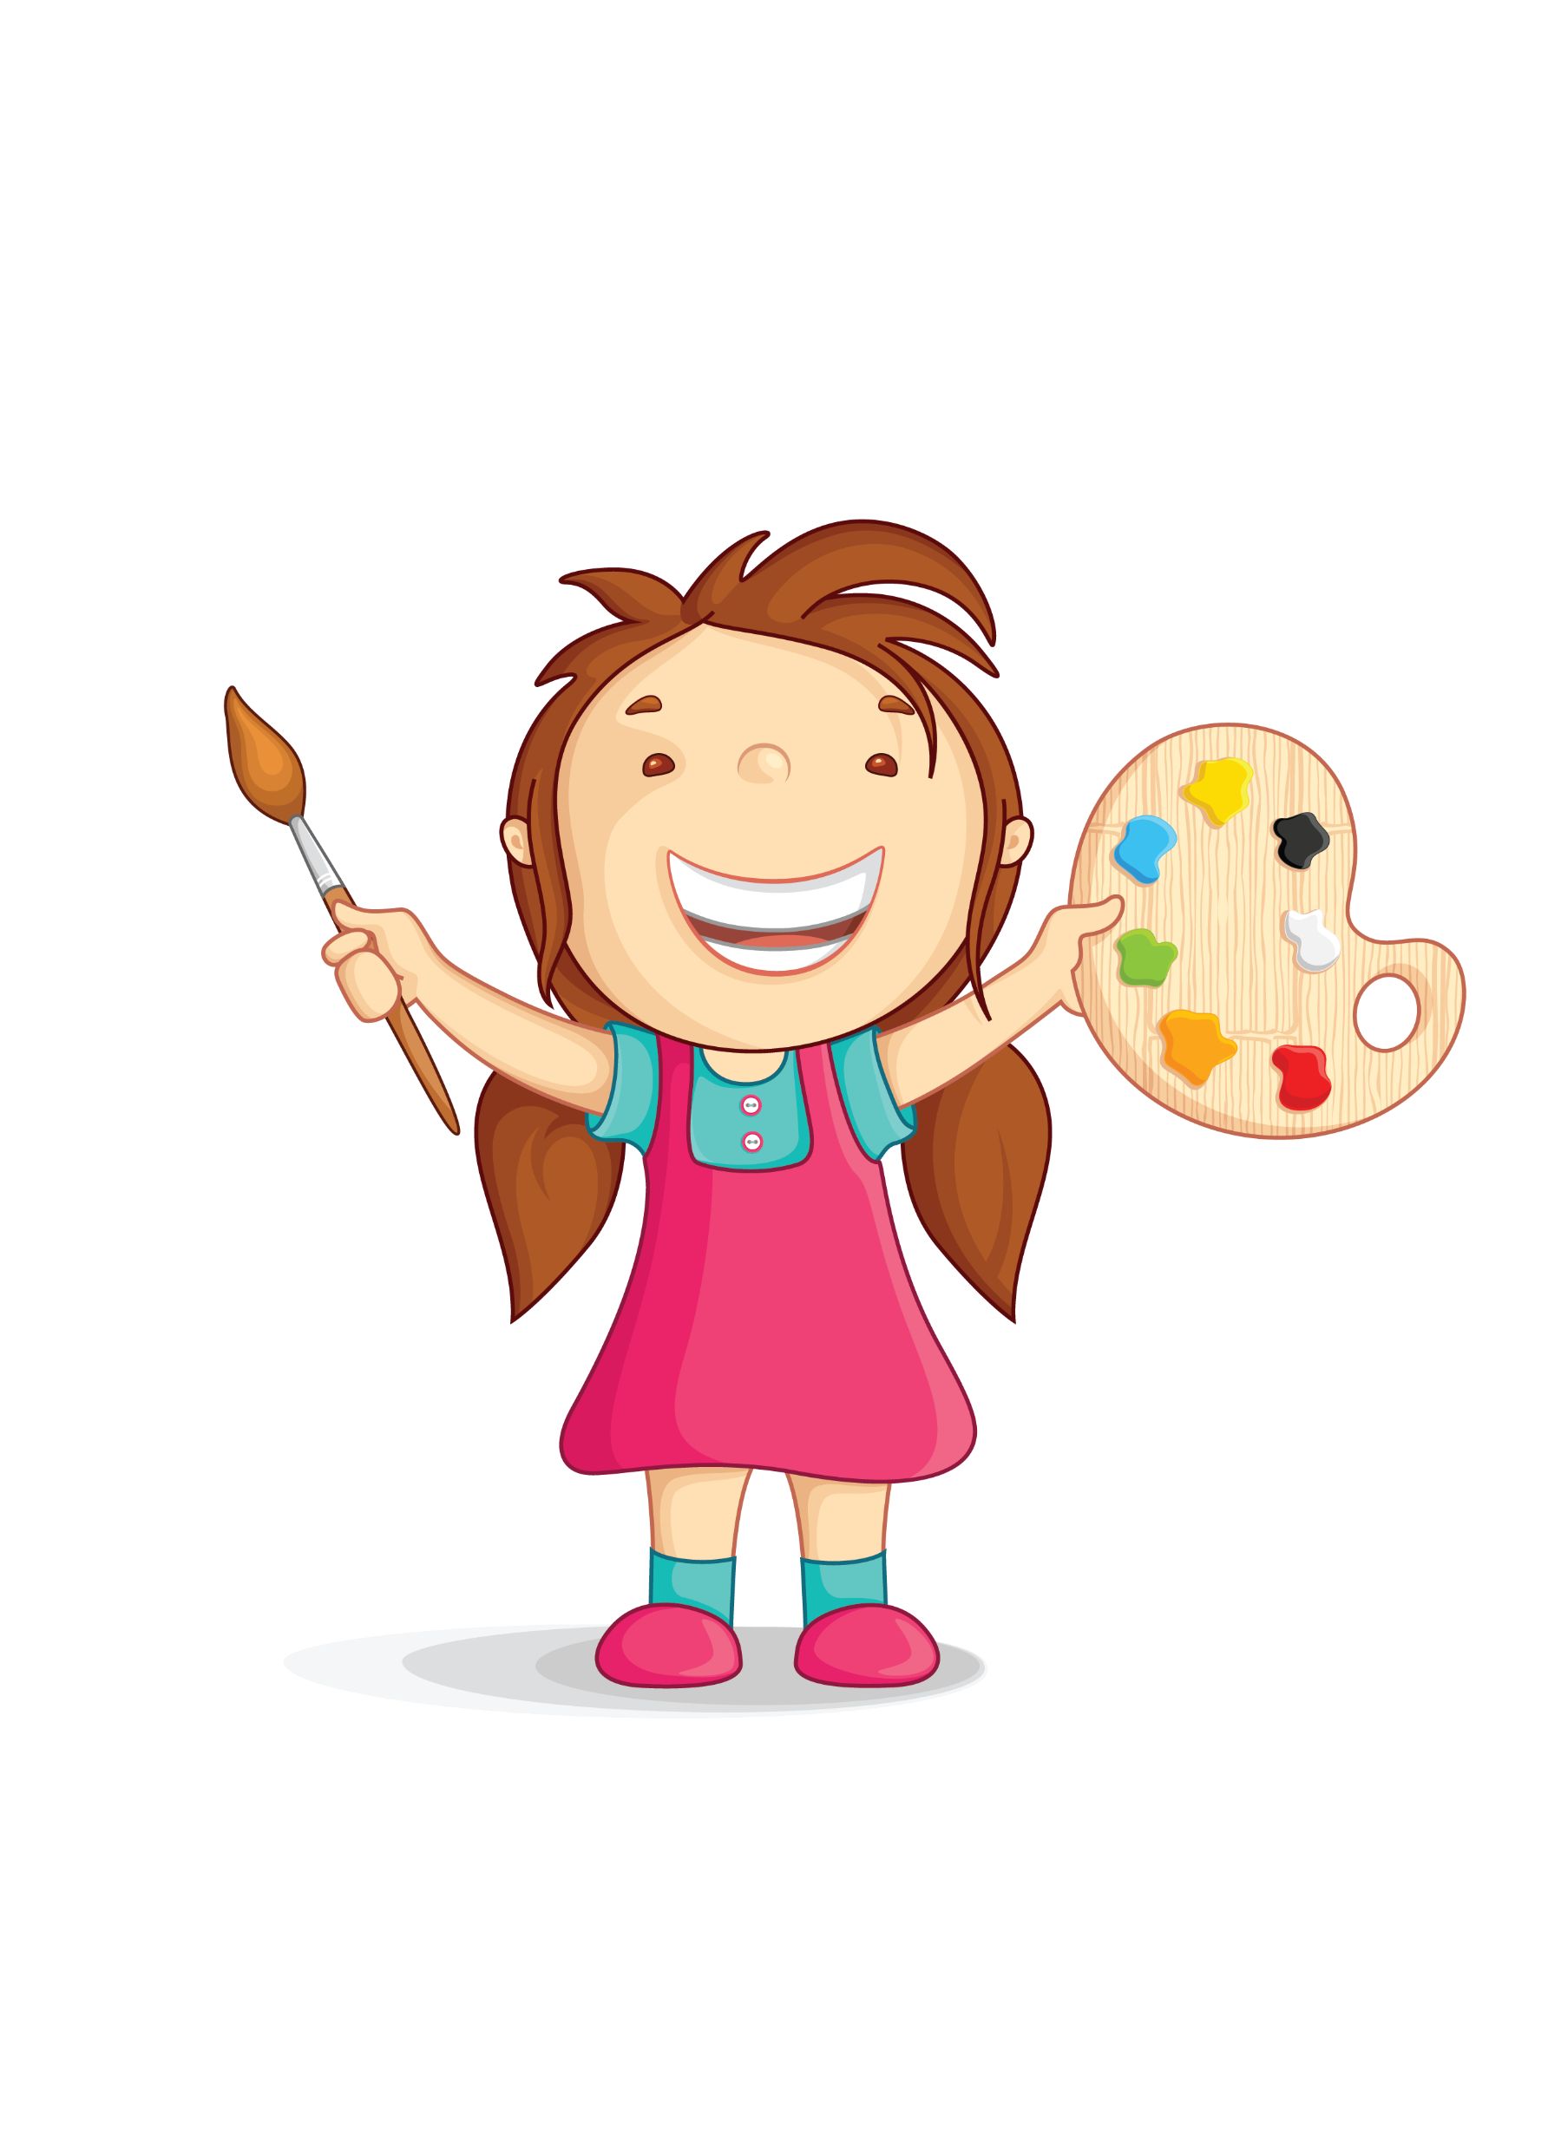
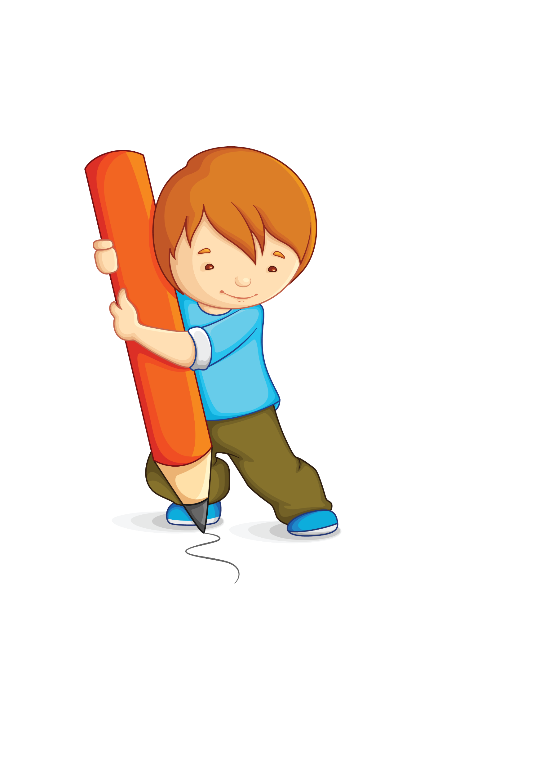
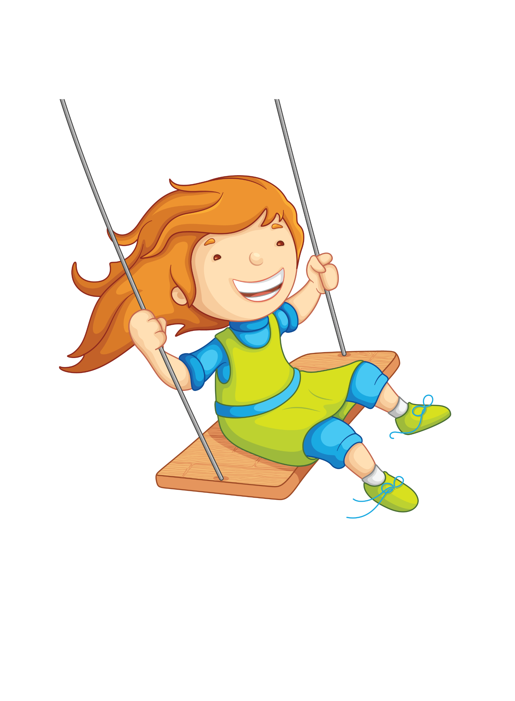
Drawing
Coloring
Singing
monday
monday
monday
friday
thursday
tuesday
wednesday
tuesday
thursday
wednesday
wednesday
tuesday
wednesday
friday
tuesday
thursday
friday
thursday
Outdoor
Activities
Pre-school
rewards
monday
friday

