Slide 1
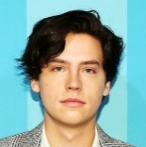
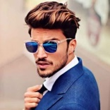
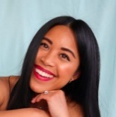
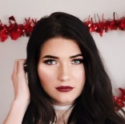
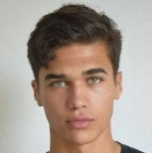
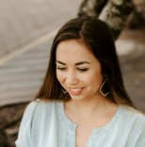
ROUND TABLE
Seating Chart
Felix Armstrong
CEO
GTX Construction
Tanya Flowers
Joe Darkwood
Marketing Manager
Ello High
Graphic Designer
LPG Monument
Brandon Lee
Elie Redbrick
CFO
GTX Construction
Lawyer
Green & Sons
Zoe Dixon
Hercul Collins
Personal Assistant
GTX Construction
Maintenance Engineer
GTX Construction
Gina Dumars
IT Specialist
Pearson Ltd
© TemplateLab.com

